Slide 1
feature 1
feature 2
…
feature n
target
feature 1
feature 2
…
feature n
target
1
2
…
n
A
B
…
A
V
W
…
W
…
C
B
…
A
X
X
X
X
1
2
…
n
A
A
…
A
V
V
…
W
…
C
C
…
A
X
X
X
X
„Root node feature“
„Root node feature“
feature 1
Altering of one instance leads to different tree
feature 2
A
…
B
V
…
W

Slide 2
X
X
X
X = Average score
X
X = Single scores
X
X
X

Slide 3
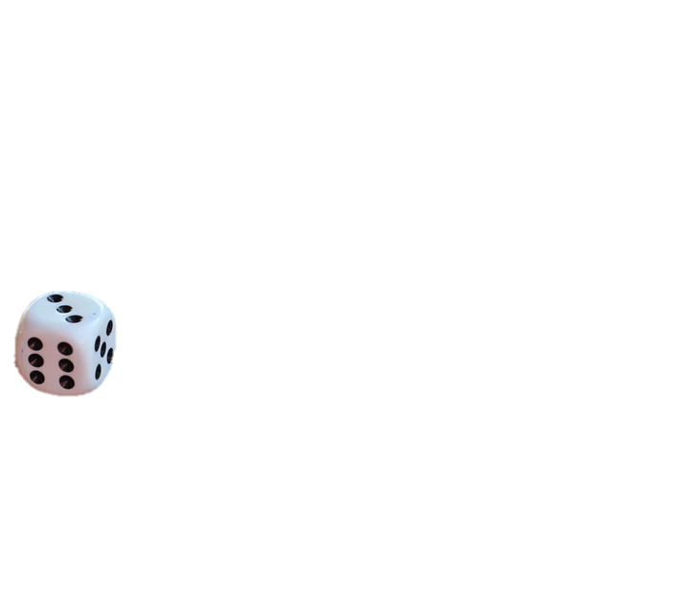
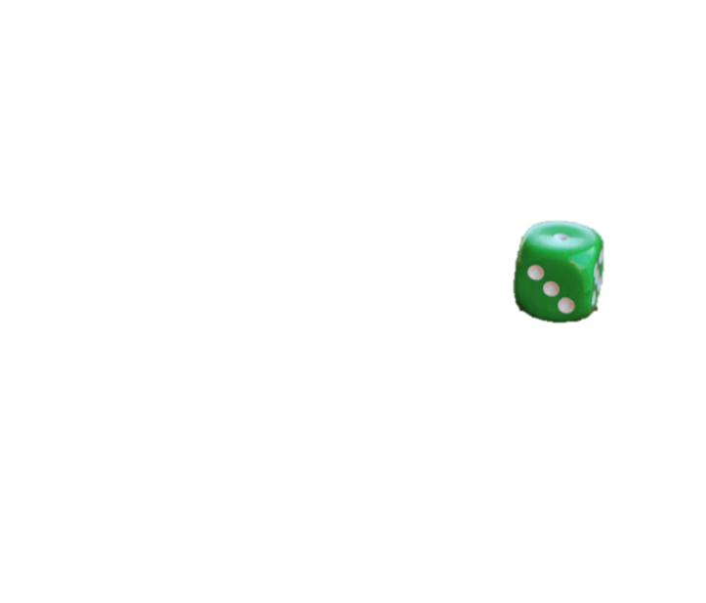


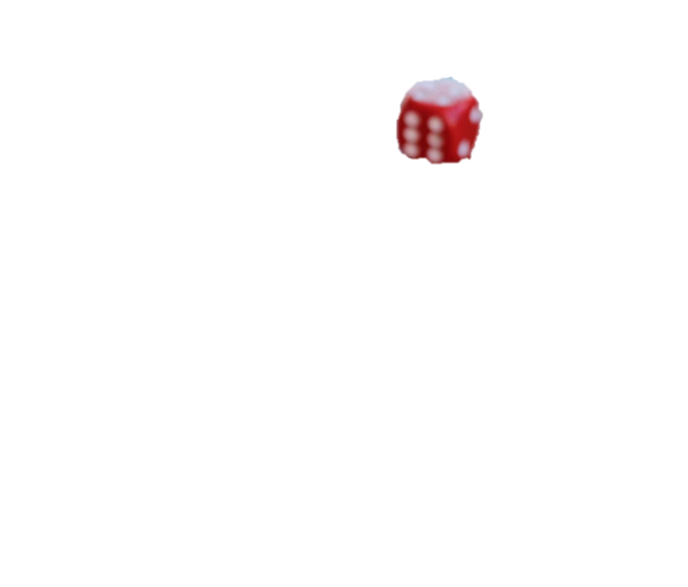

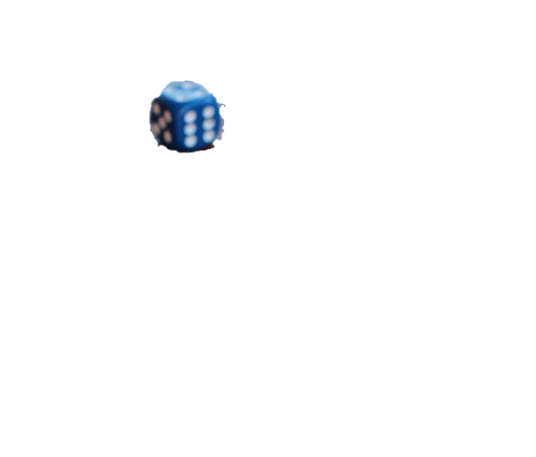


Slide 4
f1
f2
f3
…
fn
y
Original data set
f1
f10
f3
y
f5
f11
y
f4
f9
y
f2
f7
f6
y
Boosted_Subsampled_1
Boosted_Subsampled_2
Boosted_Subsampled_3
Boosted_Subsampled_4
Root node = f1
Root node = f11
Root node = f4
Root node = f2
Subspace sampling
Split
Subspace sampling
….
Leaf node
Subspace sampling
Split
Subspace sampling
….
Leaf node
Subspace sampling
Split
Subspace sampling
….
Leaf node
Subspace sampling
Split
Subspace sampling
….
Leaf node
Aggregation
Majority Vote

Slide 5


Random Forest
Tree model

